Slide 1
CONTAINER TERMINAL
OPERATIONS
From Raw Operational Data to Decision-Ready Insights
Damietta Terminal Analytics | Q1 2025 vs Q1 2026
DEPI Data Analysis Graduation Project
01
Notes:
• Open with the project promise: operational records become a governed decision-support system.
• Frame the comparison as Q1 2025 versus Q1 2026 and keep the focus on what the supplied data can support.
• Set expectations for a case-study narrative: preparation, validation, insight, and management action.
Transition: Introduce the team that built the analytical system.
Presenter caution: Do not introduce external terminal benchmarks, capacity figures, or causal explanations.
[Sources]
- User-supplied project brief and source files.

Slide 2
PROJECT TEAM
Built as a Team. Designed as One Analytical System.
DEPI Data Analysis Graduation Project
01
Abdelrahman Hany Ahmed Elsayed
05
Ayman Ibrahim Boghdady Elsaghir
02
Shehab eldin refaat mohamed hassan
06
Menna nabil abdelaziz awadallah
03
Nermeen samy fathy ahmed
07
Eugenie Aziz Adeeb Aziz
04
Nawara Elsafy Mohamed Aly
Seven contributors. One governed analytical system.
DEPI DATA ANALYSIS GRADUATION PROJECT
02
Notes:
• Present the seven contributors exactly as listed, without assigning invented roles.
• Emphasize that the work connects source interpretation, preparation, modeling, validation, and storytelling.
• Use the team slide briefly; the next slide moves immediately into the data challenge.
Transition: Explain why understanding field language was the first analytical task.
Presenter caution: Do not attribute individual workstreams or responsibilities unless the team confirms them.
[Sources]
- User-supplied project brief: required team names.

Slide 3
DATA LANDSCAPE
Before We Could Analyze the Terminal, We Had to Understand Its Language.
VESSEL
CONTAINER
YARD
ATA / ATB / ATD
Vessel / Voyage
Number / Size / Type
Operator / Full-Empty
In Date / Out Date
Stack Days / Transport
OPERATIONAL
LANGUAGE
CARGO & RISK
CONNECTIVITY
EQUIPMENT
Cargo / Commodity / Weight
IMDG / Damage
POL / POD
Country / Region
Loading / Discharging Equipment
QC information
The data dictionary translated 97 source fields into consistent business meaning.
DEPI DATA ANALYSIS GRADUATION PROJECT
03
Notes:
• Explain that the data dictionary was a control layer, not a glossary for its own sake.
• Clarify examples: ATA is arrival, ATB is berthing, ATD is departure; OPR refers to the container operator while vessel Operator is a separate concept.
• Point out that POL and POD define the connectivity network and equipment fields identify loading or discharging resources.
• The field inventory contained 97 rows; the slide groups them into six operational themes for clarity.
Transition: Show how the field definitions were converted into a repeatable preparation pipeline.
Presenter caution: Do not reproduce all dictionary rows or mix vessel operator with container operator.
[Sources]
- Container Terminal_Data Dictionary.xlsx, Data Dictionary sheet.

Slide 4
DATA PREPARATION
Cleaning Was a Pipeline - Not a Button.
RAW EXCEL
POWER QUERY
SEMANTIC MODEL
DAX
POWER BI
Operational extracts
Reference files
Types + renaming
Trim / Clean / blanks
Facts + dimensions
Keys + status fields
Governed measures
Grain-aware logic
Decision-ready
dashboards
SQL SERVER
PYTHON QA
Primary / foreign keys
Data-type alignment
Joins, CTEs, window functions
Sheet availability
Blank-row and text checks
Clean workbook copy
Power Query governed the production BI path; SQL and Python strengthened structure, exploration, and QA.
SQL and Python supported validation and analysis; final dashboard KPIs were governed through the Power Query semantic-model path.
DEPI DATA ANALYSIS GRADUATION PROJECT
04
Notes:
• Walk left to right through the production path: raw Excel and references, Power Query, semantic model, DAX, and dashboards.
• Call out concrete Power Query work: explicit types, consistent renaming, Trim/Clean, blank-row removal, SourceRowKey, UnitCount, CompletedDwellDays, and status fields.
• Position SQL as structural and exploratory support: keys, type alignment, ERD checks, joins, CTEs, and window functions.
• Position Python as supplementary workbook QA only, not the production source for Power BI.
Transition: Move from preparation steps to the architecture and validation controls that made the KPIs trustworthy.
Presenter caution: Do not claim the Python script fed the production model; the supplied Python file is empty and only the documented safe QA role is shown.
[Sources]
- Project.docx, Power Query Advanced Editor exports.
- Container_Terminal_Analytics_Final_Documentation.docx, Sections 3-6.
- SQL report.docx and final port analysis - Copy.sql.
- User-supplied governing brief for Python QA scope.

Slide 5
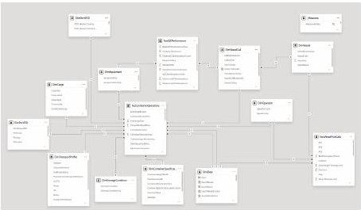
MODEL + VALIDATION
Trust Came Before Trends.
SIMPLIFIED THREE-FACT ARCHITECTURE
Vessel + Call
FactContainerOperations
Equipment
FactQCPerformance
Operator + Cargo
POL / POD
FactVesselPortCalls
ACTUAL MODEL EVIDENCE
Container Spec
Date + Profiles
Not every number was allowed to become a KPI.
one container move
one vessel-call x equipment group
one vessel call
DATE SEQUENCE
QC HOURS
MATCH STATUS
WEIGHT STATUS
DEPI DATA ANALYSIS GRADUATION PROJECT
05
Notes:
• Start with the simplified view: three facts at three distinct grains, connected through shared dimensions.
• State each grain explicitly: a container operation, a vessel-call by equipment group, and a vessel call.
• Use the actual model crop as evidence that the simplified architecture reflects a real semantic model.
• Highlight the governance principle: invalid date sequences, inconsistent QC hours, unmatched references, and weight issues were tagged before measure use.
Transition: With the trustworthy model established, introduce the central operational question.
Presenter caution: Do not imply direct fact-to-fact joins or average across mixed grains without aggregation.
[Sources]
- PowerBi_Pres.pdf, page 11, Final Semantic Model.
- Project.docx, FactContainerOperations, FactQCPerformance, and FactVesselPortCalls Power Query definitions.
- Container_Terminal_Analytics_Final_Documentation.docx, Sections 4-5.

Slide 6
BUSINESS QUESTION
PROBLEM
>
INSIGHT
>
STORY
>
ACTION
The Real Question Wasn't 'How Much Did We Move?' - It Was 'Where Did We Lose Time?'
How efficiently is the terminal converting vessel calls and container moves into throughput - and where is that efficiency being lost?
1
2
3
4
VOLUME & FLOW
EFFICIENCY
RISK & DATA QUALITY
CONNECTIVITY
Entries, exits, TEU, vessel calls
Dwell, waiting, berth time
Validation, tails, unreliable groups
Trade lanes, discharge ports, concentration
The story begins with volume - but the decision value comes from time, concentration, and trust.
DEPI DATA ANALYSIS GRADUATION PROJECT
06
Notes:
• Pose the central question exactly: how efficiently the terminal converts calls and moves into throughput, and where time is lost.
• Introduce the four lenses that structure the rest of the story: volume and flow, efficiency, risk and data quality, and connectivity.
• Explain that total volume alone cannot reveal waiting, long-dwell exceptions, or unreliable measurements.
Transition: Answer the first part with the Q1 comparison: throughput rose, but dwell moved in the wrong direction.
Presenter caution: Do not turn the lenses into causal claims; they are analytical perspectives.
[Sources]
- User-supplied project brief: central business question and PISA storyline.
- Container_Terminal_Analytics_Final_Documentation.docx, business-question framing.

Slide 7
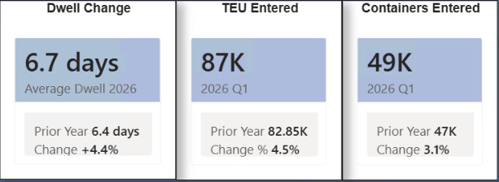
EXECUTIVE INSIGHT
PROBLEM
>
INSIGHT
>
STORY
>
ACTION
Q1 2026 Moved More TEU - But Containers Stayed Longer.
TEU ENTERED
82.85K
~87K
+4.5%
CONTAINERS ENTERED
~47K
~49K
+3.1%
Volume increased in Q1 2026. Average dwell also increased modestly.
AVERAGE DWELL (DAYS)
6.4
6.7
+4.4%
Throughput momentum
Time efficiency
DEPI DATA ANALYSIS GRADUATION PROJECT
07
Notes:
• Lead with the tension: Q1 2026 handled more TEU and more containers, while average dwell also rose.
• State the three comparisons: TEU entered approximately 82.85K to 87K, containers entered approximately 47K to 49K, and dwell 6.4 to 6.7 days.
• Highlight the different managerial meanings: volume growth is positive; the dwell increase is an attention signal.
• Pause before discussing causes - the supplied data establishes the pattern, not the reason.
Transition: Clarify the most common flow mistake: reporting-window gaps are not current yard inventory.
Presenter caution: Do not claim why dwell increased or use older conflicting figures from the documentation.
[Sources]
- WhatsApp Image 2026-08-17 at 2.30.39 AM.jpeg, latest Executive Overview screenshot.
- User-supplied current authoritative metrics.

Slide 8
FLOW VS INVENTORY
PROBLEM
>
INSIGHT
>
STORY
>
ACTION
A 6.1K Reporting-Window Gap Does Not Mean 6.1K Containers Are Still in the Yard.
ENTRY-COHORT TIMELINE
95,325
89,221
Container Entries
Container Exits
SOME EXITS OCCUR
AFTER Q1
CURRENT
SNAPSHOT
Q1 ENTRY
168,345
158,090
TEU Entered
TEU Exited
19
containers currently active
in the terminal snapshot
+6,104
containers in the selected reporting-window difference
+10,255 TEU difference
Two valid measures. Two different questions.
Entry cohort / reporting window
Current active inventory snapshot
DEPI DATA ANALYSIS GRADUATION PROJECT
08
Notes:
• Show the combined selected-period totals: 95,325 entries, 89,221 exits, 168,345 TEU entered, and 158,090 TEU exited.
• Compute the reporting-window differences explicitly: 6,104 containers and 10,255 TEU.
• Explain the cohort logic: a container entering in Q1 may exit after Q1, so the period difference is not a yard-stock measure.
• Contrast that with the separate current snapshot of 19 active containers.
Transition: Move from flow totals to the shape of dwell performance, where the long tail matters more than the average alone.
Presenter caution: Never call 6,104 current yard inventory.
[Sources]
- WhatsApp Image 2026-08-17 at 2.30.41 AM.jpeg, latest Container Flow and Dwell screenshot.
- WhatsApp Image 2026-08-17 at 2.30.39 AM.jpeg, latest Executive Overview screenshot.
- User-supplied Q1 cohort guardrail.

Slide 9
DWELL DISTRIBUTION
PROBLEM
>
INSIGHT
>
STORY
>
ACTION
Most Containers Clear in 4 Days - The Slowest 10% Need More Than 13.
RIGHT-SKEWED DWELL PROFILE
4 days
MEDIAN 4
P90 13.2
Median completed dwell
TYPICAL CONTAINER
6.6 days
Average completed dwell
PULLED UP BY THE TAIL
13.2 days
P90 completed dwell
SLOWEST 10%
The average is not the typical experience. A smaller long-dwell tail needs exception-based monitoring.
Illustrative distribution shape; percentile markers use the actual dashboard metrics.
DEPI DATA ANALYSIS GRADUATION PROJECT
09
Notes:
• Compare the three statistics: median 4 days, average 6.6 days, and P90 13.2 days.
• Explain that the average exceeds the median because a smaller set of long-stay containers pulls it upward.
• The illustrated curve is deliberately not a frequency claim; it only communicates the right-skewed shape implied by the percentile gap.
• Introduce exception-based monitoring for containers, commodities, or routes crossing defined dwell thresholds.
Transition: Shift from container time to vessel time and isolate where tracked turnaround is being consumed.
Presenter caution: Do not claim the long-dwell tail worsened sharply year over year; the latest screenshot does not establish that.
[Sources]
- WhatsApp Image 2026-08-17 at 2.30.41 AM.jpeg, latest flow and dwell metrics.
- User-supplied authoritative dwell metrics.

Slide 10
VESSEL PERFORMANCE
PROBLEM
>
INSIGHT
>
STORY
>
ACTION
Nearly Half of Tracked Vessel Turnaround Happens Before Berthing.
46.4 h
22.5 h
23.9 h
48.5%
of average tracked turnaround
occurs before berthing
Average turnaround
Average pre-berth waiting
Average berth time
VESSEL TIMELINE
177
PRE-BERTH WAITING | 22.5 h
BERTH OCCUPANCY | 23.9 h
tracked vessel calls
ATA
ATB
ATD
82 vessels
Actual Time of Arrival
Actual Time of Berthing
Actual Time of Departure
Pre-berth waiting is the first place management should investigate.
Selected vessel-call records; not all terminal calls.
DEPI DATA ANALYSIS GRADUATION PROJECT
10
Notes:
• State the selected detailed scope before interpreting the metrics: 177 tracked calls across 82 vessels.
• Break average turnaround into 22.5 hours before berth and 23.9 hours at berth, totaling 46.4 hours.
• Calculate the pre-berth share as 22.5 divided by 46.4, approximately 48.5 percent.
• Frame waiting as the first investigation point, not proof of a capacity or scheduling cause.
Transition: Move from vessel time to equipment workload and ask where operational demand is concentrated.
Presenter caution: Do not present the 177-call selected dataset as every terminal call, and do not claim berth capacity is the cause.
[Sources]
- WhatsApp Image 2026-08-17 at 2.30.42 AM.jpeg, latest Vessel Port Call and Berth screenshot.
- User-supplied authoritative selected-vessel metrics.

Slide 11
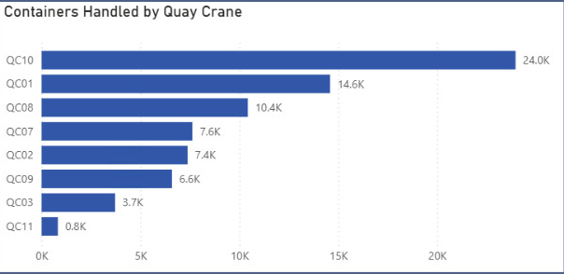
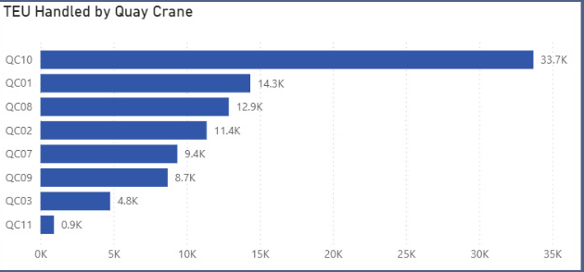
EQUIPMENT WORKLOAD
PROBLEM
>
INSIGHT
>
STORY
>
ACTION
One Quay Crane Carries the Heaviest Share of the Workload.
QC10
QC01
QC08
QC02
24.0K containers
14.6K containers
10.4K containers
7.4K containers
33.7K TEU
14.3K TEU
12.9K TEU
11.4K TEU
Workload is materially concentrated on QC10 - validate productivity before changing allocation.
DEPI DATA ANALYSIS GRADUATION PROJECT
11
Notes:
• Use only the containers-handled and TEU-handled views from the latest equipment page.
• Describe QC10 as the highest-workload quay crane: approximately 24.0K containers and 33.7K TEU.
• Compare the next cranes: QC01, QC08, and QC02 are materially lower on handled volume.
• Frame the management follow-up as an investigation into allocation, availability, maintenance exposure, and validated productivity.
Transition: Before interpreting any efficiency metric, show the QC working-hour validation rate that limits trustworthy productivity analysis.
Presenter caution: Do not use the TEU-per-QC-working-hour chart and do not call QC10 the most productive crane.
[Sources]
- WhatsApp Image 2026-08-17 at 2.30.40 AM (2).jpeg, latest Equipment Workload screenshot.
- User-supplied authoritative equipment workload figures.

Slide 12
DATA QUALITY
PROBLEM
>
INSIGHT
>
STORY
>
ACTION
Almost One in Four QC Groups Was Too Inconsistent to Trust.
1,087
838
Total QC groups
Validated groups
77.1%
249
22.9%
VALIDATED
Inconsistent groups
Inconsistent share
Different working-hour values inside the same vessel-call x equipment group were excluded - not silently averaged.
VALIDATION LOGIC
Group -> count distinct hours -> validate only when count = 1
DEPI DATA ANALYSIS GRADUATION PROJECT
12
Notes:
• Start with the population: 1,087 vessel-call by equipment groups.
• Of those, 838 were validated and 249 contained multiple conflicting working-hour values.
• Translate this into rates: 77.1 percent validated and 22.9 percent inconsistent.
• Explain the governance decision: inconsistent groups were left out of validated productivity logic rather than averaged into a misleading KPI.
Transition: With trusted workload measures in place, show how demand is concentrated across operators.
Presenter caution: Do not quote unreliable productivity outputs derived from inconsistent QC-hour groups.
[Sources]
- Project.docx, CheckQCWorkingHours and FactQCPerformance Power Query definitions.
- PowerBi_Pres.pdf, pages 9 and 21.
- Container_Terminal_Analytics_Final_Documentation.docx, QC working-hour inconsistency section.

Slide 13
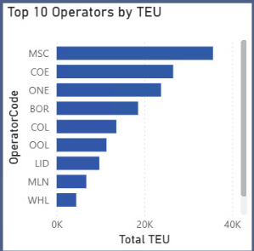
OPERATOR CONCENTRATION
PROBLEM
>
INSIGHT
>
STORY
>
ACTION
A Small Carrier Group Drives a Large Share of Terminal Workload.
THE LEADING GROUP
01
MSC
02
COE
03
ONE
A limited group of operators strongly shapes terminal workload and planning demand.
Use operator segmentation to frame workload, schedule, and service-level reviews.
DEPI DATA ANALYSIS GRADUATION PROJECT
13
Notes:
• Use the current Power BI visual qualitatively: MSC leads, followed by COE and ONE.
• Emphasize concentration without assigning exact market shares that are not clearly visible.
• Explain why concentration matters operationally: a small set of operators can strongly shape workload timing and planning demand.
• Suggest operator-segmented reviews as a management lens, not as a performance judgment.
Transition: Extend the concentration story from operators to the port network and trade lanes.
Presenter caution: Do not invent operator market-share percentages.
[Sources]
- WhatsApp Image 2026-08-17 at 2.30.39 AM.jpeg, latest Executive Overview Top Operators by TEU visual.

Slide 14
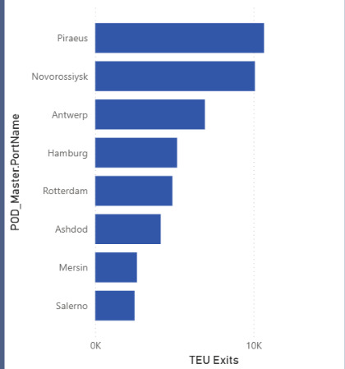
PORT CONNECTIVITY & TRADE LANES
PROBLEM
>
INSIGHT
>
STORY
>
ACTION
118 Trade Lanes Connect 21 Countries - But Volume Clusters Around a Few Ports.
15
POD regions
21
POD countries
50
Discharge ports
118
Trade lanes
158.09K
TEU exited
Abstract network view - not to geographic scale
TOP DISCHARGE PORTS BY TEU EXITED
Novorossiysk
Antwerp
Piraeus
Hamburg
DAMIETTA
HUB
Salerno
Rotterdam
Mersin
Ashdod
DEPI DATA ANALYSIS GRADUATION PROJECT
14
Notes:
• Introduce the network scale: 15 POD regions, 21 POD countries, 50 discharge ports, and 118 active trade lanes.
• State the combined selected-period flow as 158.09K TEU exited.
• Use the supplied ranking to name leading discharge ports: Piraeus, Novorossiysk, Antwerp, Hamburg, Rotterdam, Ashdod, Mersin, and Salerno.
• Interpret the pattern as network breadth with volume clustering, without labeling every POL-POD route as outbound.
Transition: Next, contrast what dominates cargo volume with what appears in the higher-dwell commodity mix.
Presenter caution: Use 'TEU Exited' and 'Port Connectivity & Trade Lanes'; do not use outdated outbound-only wording for the whole network.
[Sources]
- WhatsApp Image 2026-08-17 at 2.30.40 AM.jpeg, latest Port Connectivity & Trade Lanes screenshot.
- User-supplied connectivity metrics and wording guardrails.

Slide 15
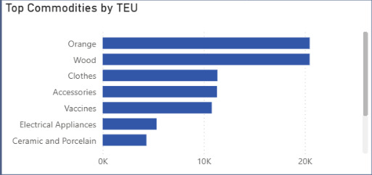
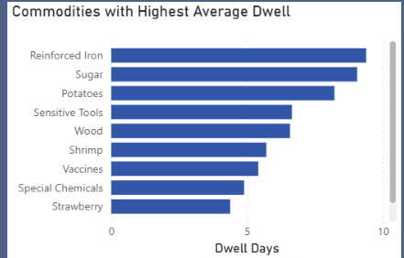
CARGO + DWELL
PROBLEM
>
INSIGHT
>
STORY
>
ACTION
Cargo Volume Is Concentrated - Dwell Pressure Comes From a Different Mix.
VOLUME MIX
111.6K TEU
General Dry
54.9K TEU
Refrigerated
Virtually all visible TEU volume sits in these two container types.
HIGHER-DWELL COMMODITIES
Reinforced Iron
Sugar
Potatoes
Sensitive Tools
Wood
What dominates volume is not necessarily what dominates dwell risk.
DEPI DATA ANALYSIS GRADUATION PROJECT
15
Notes:
• Start with container-type concentration: approximately 111.6K TEU General Dry and 54.9K TEU Refrigerated.
• Explain that these two types account for virtually all visible TEU volume, while other types are much smaller.
• Contrast volume with higher-dwell commodities shown in the dashboard: Reinforced Iron, Sugar, Potatoes, Sensitive Tools, and Wood.
• Use this contrast to motivate targeted dwell reviews by commodity rather than only by total volume.
Transition: Convert the evidence into four practical operational levers.
Presenter caution: Do not build any insight around Electrical Appliances versus Electronic Devices, and do not infer causes for commodity dwell.
[Sources]
- WhatsApp Image 2026-08-17 at 2.30.41 AM (1).jpeg, latest Cargo and Commodity screenshot.
- User-supplied authoritative cargo figures and naming guardrails.

Slide 16
MANAGEMENT ACTION
PROBLEM
>
INSIGHT
>
STORY
>
ACTION
Four Operational Levers Can Turn Visibility Into Performance.
01
CONTROL THE
LONG-DWELL TAIL
03
BALANCE CRANE
WORKLOAD
Exception monitoring for containers, commodities, and routes beyond defined thresholds.
Use workload and validated productivity together before changing allocation.
02
INVESTIGATE
PRE-BERTH WAITING
04
FIX QC LOGGING
QUALITY
Break waiting down by operator, call, arrival timing, and berth sequence.
Investigate the source of the 22.9% inconsistent QC-group rate.
Investigate -> validate -> act -> measure again
DEPI DATA ANALYSIS GRADUATION PROJECT
16
Notes:
• Present the four levers as investigations and operating routines, not promised savings.
• First, create exception monitoring around the long-dwell tail.
• Second, decompose pre-berth waiting; third, balance crane workload using validated productivity; fourth, improve QC logging quality.
• Close the loop: investigate, validate, act, and measure again in the same governed model.
Transition: Before closing, make the analytical boundaries explicit so decisions remain disciplined.
Presenter caution: Do not attach invented savings, targets, or causal explanations to the four actions.
[Sources]
- User-supplied project brief: required four-action structure.
- Latest Power BI screenshots and validation logic cited on slides 7-15.

Slide 17
SCOPE + REPORTING GUARDRAILS
PROBLEM
>
INSIGHT
>
STORY
>
ACTION
Strong Decisions Start With Clear Boundaries.
01
Comparison scope
Q1 2025 versus Q1 2026
02
Container cohort
A Q1 entry can exit after the quarter
03
Vessel detail
Selected vessel-call records, not every terminal call
04
Interpretation
Timing patterns and correlations are not automatically causes
05
Benchmarking
No external benchmarks were required for this case study
DEPI DATA ANALYSIS GRADUATION PROJECT
17
Notes:
• Use this slide to protect interpretation, not to apologize for the analysis.
• Restate the Q1 comparison and entry-cohort logic.
• Reinforce the selected scope of the detailed vessel dataset and separate patterns from causes.
• Note that the project did not require external benchmarks; conclusions are grounded in the supplied operational data.
Transition: Close by connecting raw records, governed preparation, validated KPIs, insight, and action.
Presenter caution: Do not mention internal dashboard mistakes on the visible slide; keep the wording focused on analytical boundaries.
[Sources]
- User-supplied project brief: Q1 scope and analytical guardrails.
- Latest Power BI screenshots and project documentation.

Slide 18
CONCLUSION
PROBLEM
>
INSIGHT
>
STORY
>
ACTION
From Raw Records to Operational Decisions.
01
02
03
04
+4.5%
4 / 6.6 / 13.2
48.5%
QC10 + 22.9%
TEU entered in Q1 2026
Median / average / P90 dwell days
Tracked turnaround before berthing
Workload concentration + QC-hour inconsistency
RAW DATA
TRUSTED
PREPARATION
GOVERNED
MODEL
VALIDATED
KPIs
OPERATIONAL
INSIGHTS
ACTION
The project transformed fragmented operational records into a governed decision-support system for terminal performance.
THANK YOU
DEPI DATA ANALYSIS GRADUATION PROJECT
18
Notes:
• Resolve the opening question with four evidence-backed findings: growth, dwell distribution, pre-berth waiting, and equipment/data-quality concentration.
• Rehearse the delivery chain from raw records through trusted preparation, governed modeling, validated KPIs, operational insight, and action.
• End on the value delivered: a reusable decision-support system, not just a collection of dashboards.
• Invite questions after the closing line rather than adding a separate empty thank-you slide.
Transition: Open the appendix only if the panel asks for weight analysis, row-level traceability, or technical methods.
Presenter caution: Do not add external impact claims, savings, or benchmarks in the close.
[Sources]
- Latest Power BI screenshots supplied with the project.
- Project.docx and Container_Terminal_Analytics_Final_Documentation.docx.
- User-supplied authoritative metrics and closing language.

Slide 19
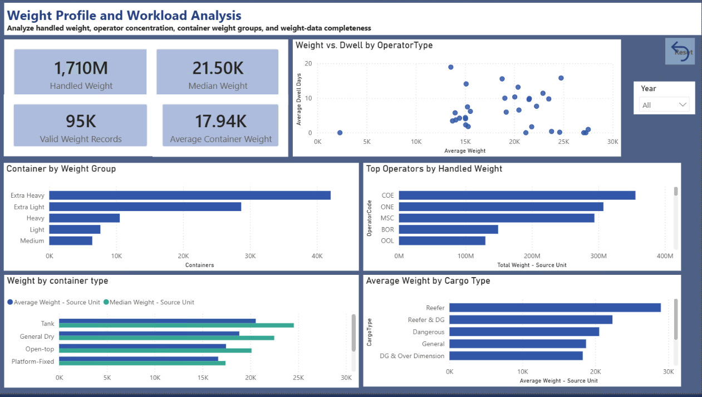
OPTIONAL APPENDIX
Appendix A - Weight Profile and Workload
WEIGHT
PROFILE
Use for relative workload and completeness analysis.
SOURCE UNIT
No conversion to kg, tonnes, or another business unit.
DEPI DATA ANALYSIS GRADUATION PROJECT
19
Notes:
• Use this appendix only if the panel asks about weight completeness or relative workload patterns.
• Keep all values in source unit because the business unit is not confirmed.
• Emphasize relative distributions by operator, cargo type, container type, and weight group.
Transition: Return to the main conclusion or move to row-level traceability.
Presenter caution: Never convert source-unit values into kilograms, tonnes, or another unit.
[Sources]
- WhatsApp Image 2026-08-17 at 2.30.41 AM (2).jpeg, latest Weight Profile screenshot.

Slide 20
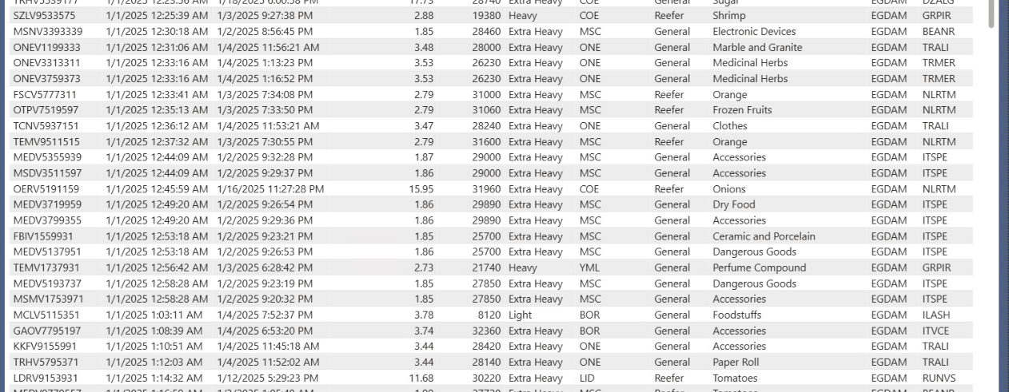
OPTIONAL APPENDIX
Appendix B - Traceability to Container-Level Records
Executive KPI -> filtered visual -> row-level container lifecycle
DEPI DATA ANALYSIS GRADUATION PROJECT
20
Notes:
• Use the row-level table to demonstrate traceability from an executive KPI back to container number, dates, dwell, weight, operator, cargo, commodity, and POL/POD.
• Explain that drill-through supports validation and investigation without replacing aggregate performance views.
• Point out that the detail page preserves the same semantic model definitions used by the summary pages.
Transition: Move to technical methods if the panel wants implementation detail.
Presenter caution: Do not expose or discuss individual records beyond their role in analytical traceability.
[Sources]
- WhatsApp Image 2026-08-17 at 2.30.42 AM (1).jpeg, latest Container Detail and Lifecycle screenshot.

Slide 21
OPTIONAL APPENDIX
Appendix C | Technical Methods
POWER QUERY
SQL SERVER
PYTHON QA
Transform example
Safe structural example
Supplementary workbook QA
Table.TransformColumnTypes
Table.RenameColumns
Text.Trim / Text.Clean
Table.SelectRows
Table.AddIndexColumn
WITH Calls AS (
SELECT VesselCallKey,
COUNT(*) AS Moves
FROM FactContainerOperations
GROUP BY VesselCallKey
)
SELECT * FROM Calls;
Check file and sheet availability
Read multiple sheets
Remove completely blank rows
Trim text case-insensitively
Derived controls
Preserve numeric and date types
SourceRowKey | UnitCount
CompletedDwellDays
DateSequenceStatus
Keys | type alignment | ERD validation
joins | CTEs | window functions
Write a cleaned workbook copy
Supporting layer - not the production BI source
Power BI KPIs were governed by the Power Query / semantic-model path.
DEPI DATA ANALYSIS GRADUATION PROJECT
21
Notes:
• Use this appendix to show representative methods, not every line of implementation.
• Power Query handled the production staging and semantic-model path; the listed steps come directly from Project.docx.
• The SQL example preserves grain by aggregating container operations to vessel call before further analysis.
• Python is shown only as supplementary workbook QA; it is not presented as the source feeding Power BI.
Transition: Return to the conclusion and invite questions.
Presenter caution: Do not show flawed SQL QC-productivity logic or UserVoyage-only Python deduplication.
[Sources]
- Project.docx, Power Query Advanced Editor exports.
- SQL report.docx and final port analysis - Copy.sql.
- User-supplied governing brief for safe Python QA scope.

